Slide 1
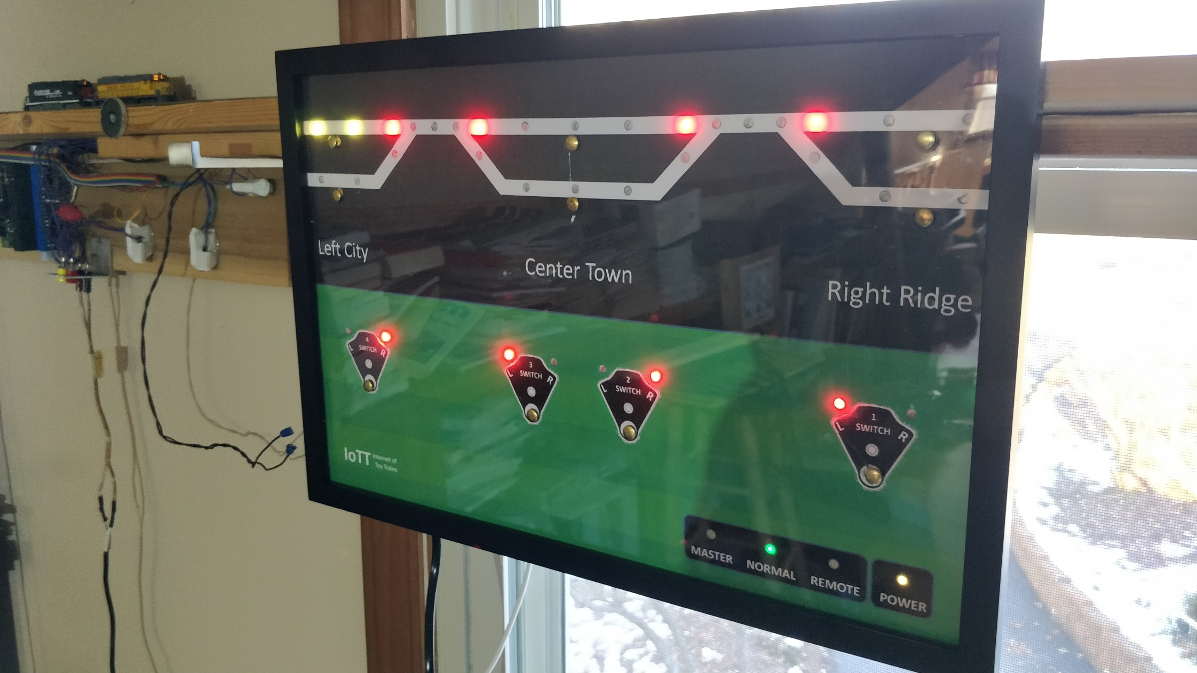
Inside the
CTC Panel Yellow Box

Slide 3
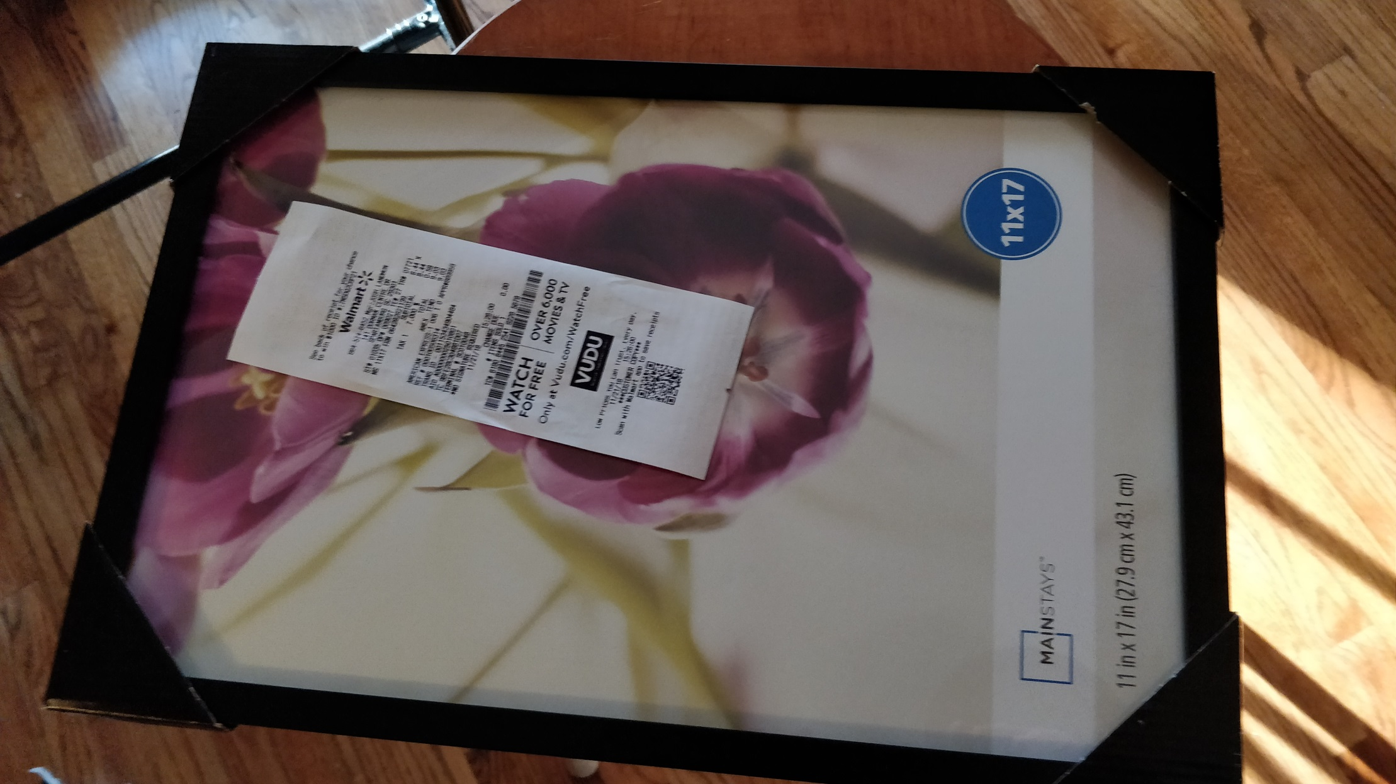

Slide 4
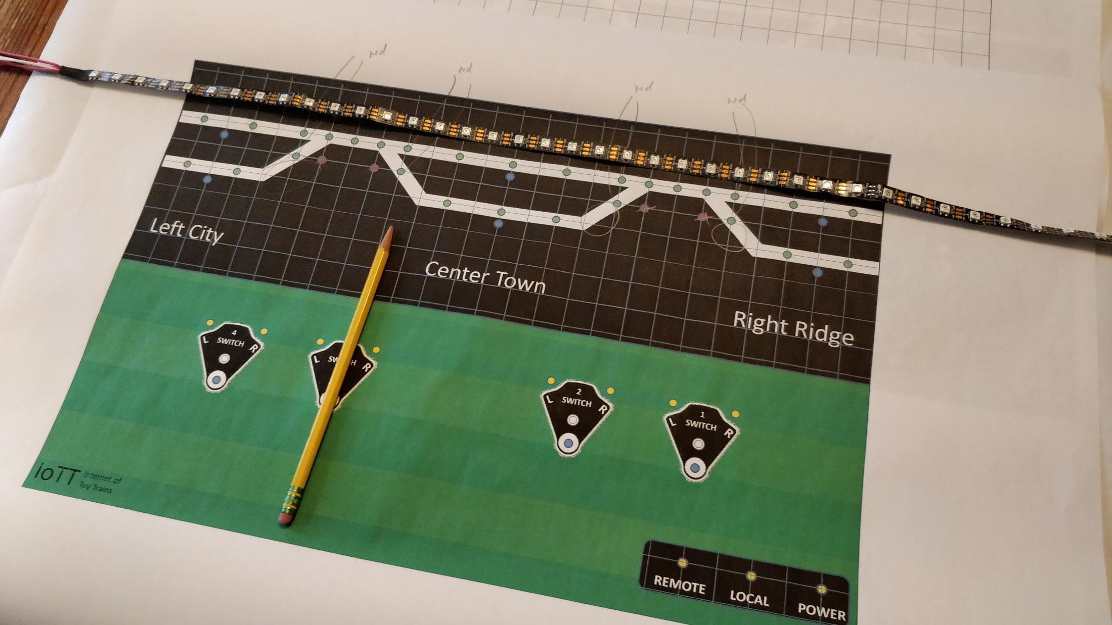

Slide 5
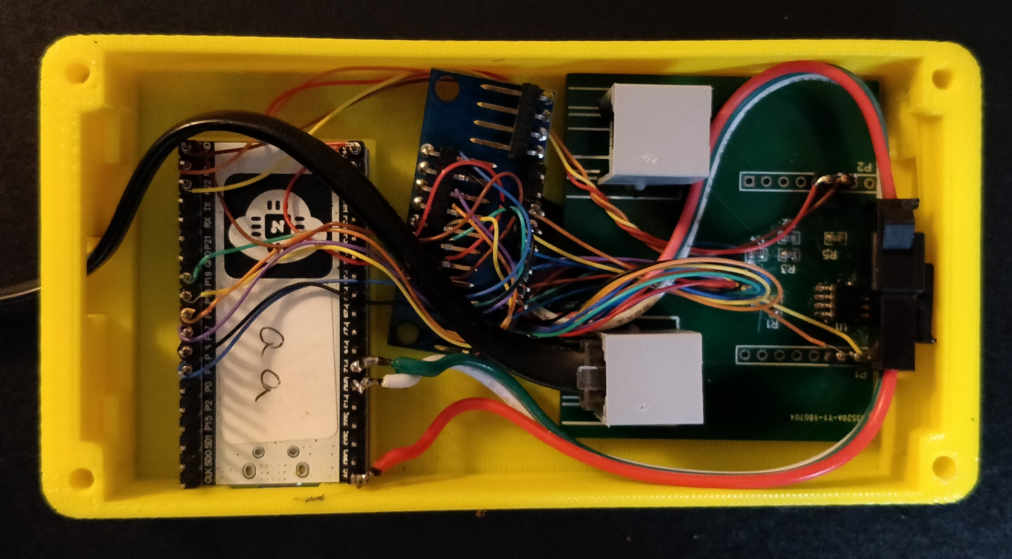
NodeMCD 32-S Controller

Slide 6
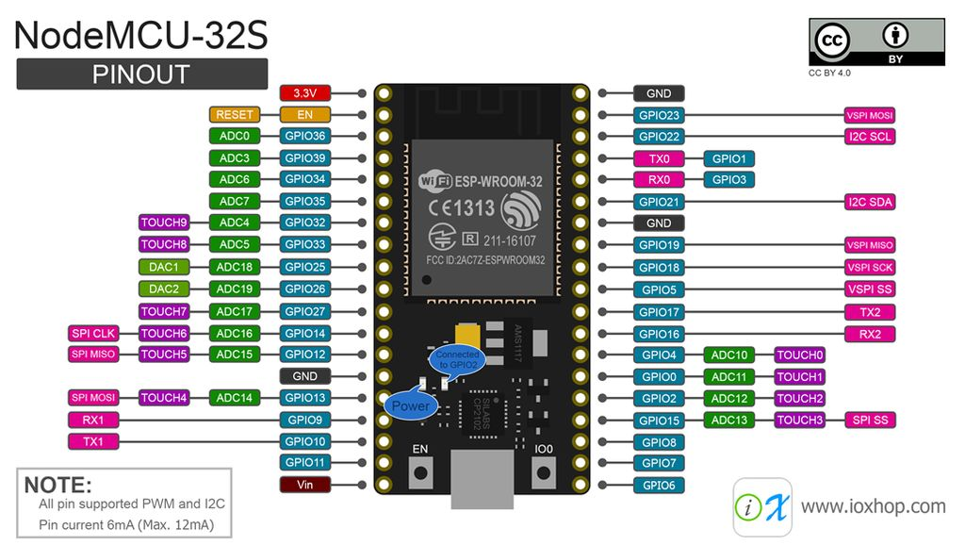

Slide 7
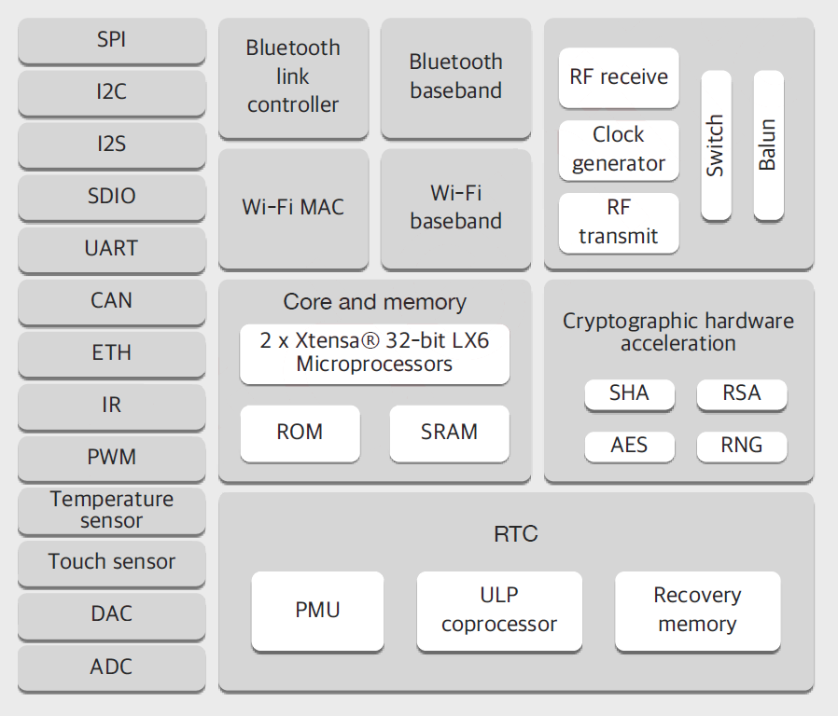

Slide 9
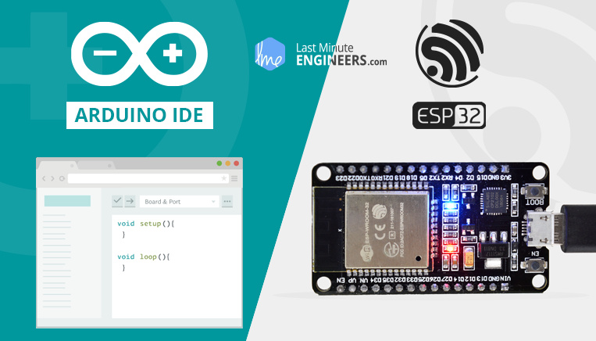

Slide 10
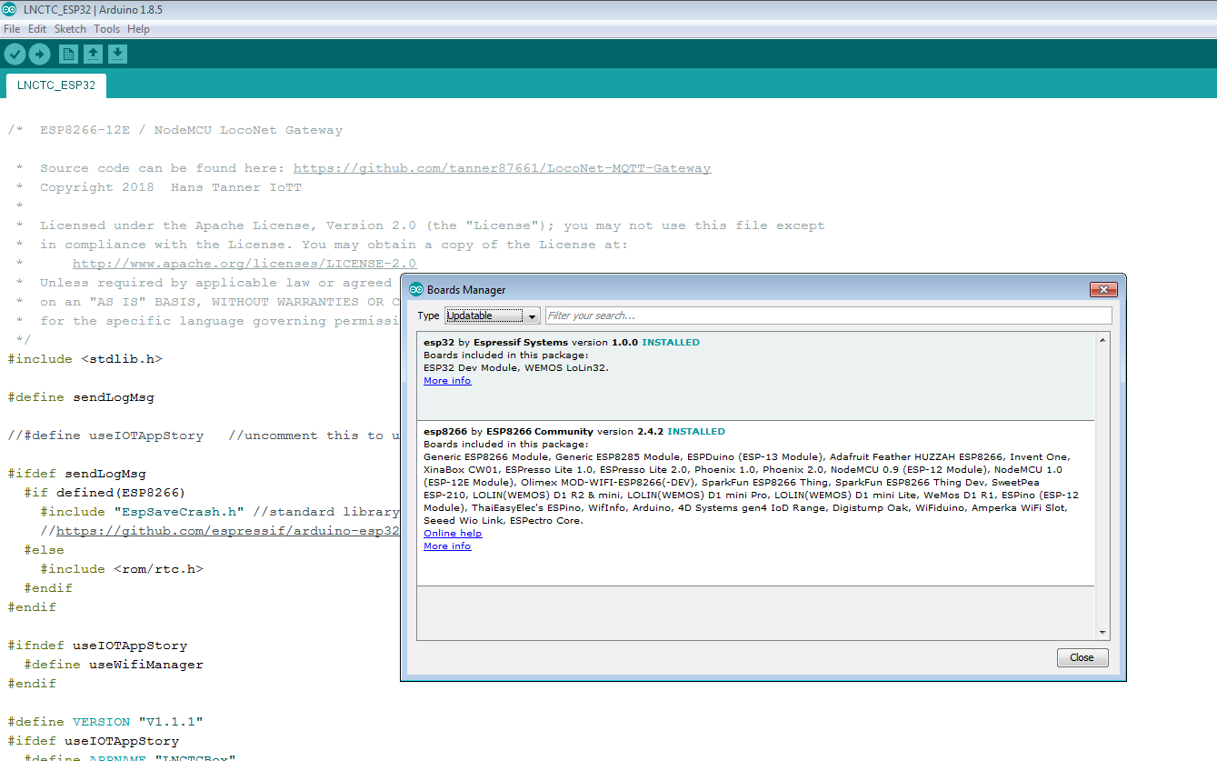

Slide 12
Touch Button Multiplexer
NodeMCD 32-S Controller
LED Chain Connection

Slide 14
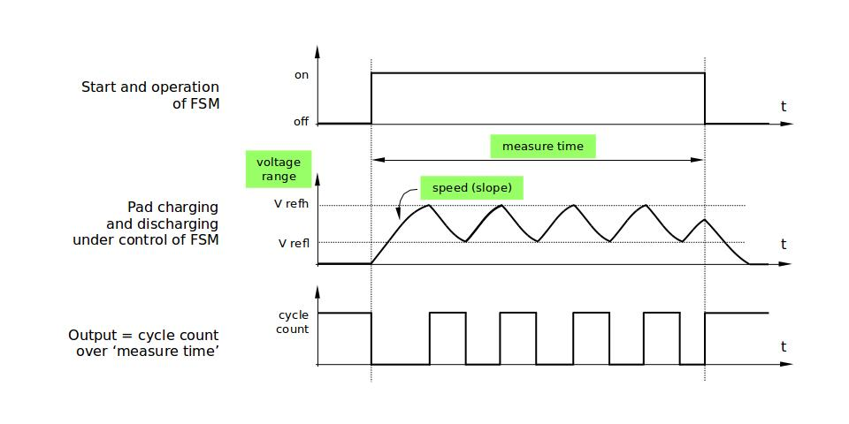
Touch Pad Measuring Principle
Source: ESP32 Technical Documentation

Slide 15
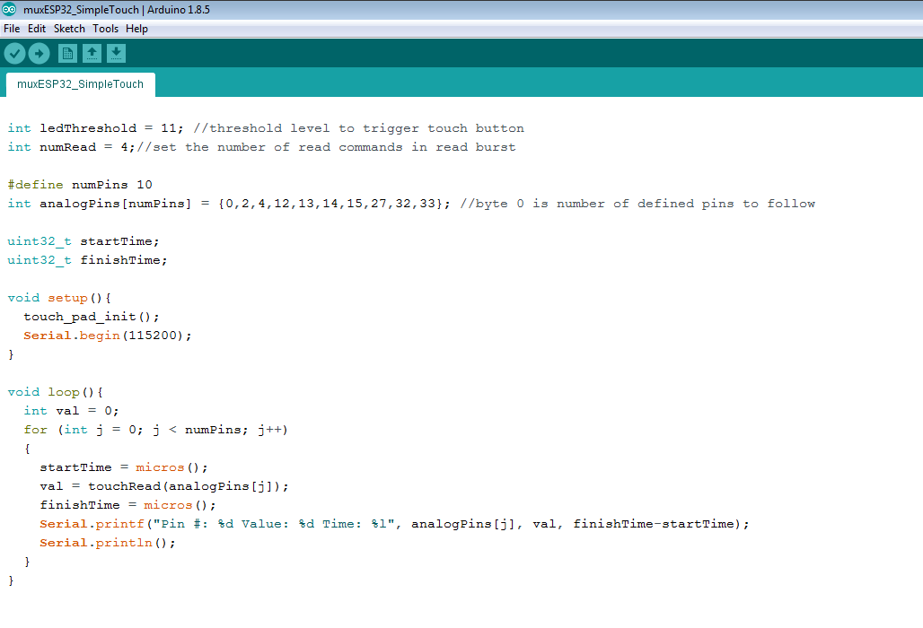

Slide 16
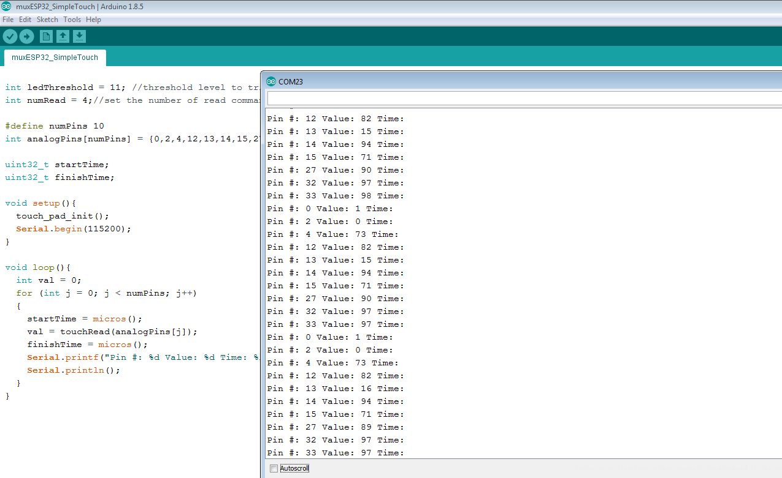
Not useable
Touched typ. 15
Untouched 70-90

Slide 17
Direct Touch Input Measurements
GPIO # | 0 | 2 | 4 | 12 | 13 | 14 | 15 | 27 | 32* | 33*
Open Value | 1 | 0 | 73 | 82 | 77 | 94 | 71 | 89 | 97 | 97
6” Wire connected | 1 | 0 | 61 | 69 | 59 | 78 | 59 | 74 | 82 | 80
Touch Value | 1 | 0 | 14 | 14 | 13 | 17 | 15 | 15 | 15 | 14
* Pins mismatched compared to label on board, also for some reason untouched value is higher on these two pins

Slide 18
Multiplexed Touch Input Measurements on GPIO #13*
MUX Input | 0 | 1 | 2 | 3 | 4 | 5 | 6 | 7 | 8 | 9 | 10 | 11 | 12 | 13 | 14 | 15
Open Value | 16 | 16 | 16 | 16 | 16 | 16 | 16 | 16 | 16 | 16 | 16 | 16 | 16 | 16 | 16 | 16
Cable connected | 15 | 15 | 15 | 15 | 15 | 15 | 15 | 15 | 15 | 15 | 15 | 15 | 15 | 15 | 15 | 15
Touch Value | 8 | 8 | 8 | 8 | 8 | 8 | 8 | 8 | 8 | 8 | 8 | 8 | 8 | 8 | 8 | 8
* Other tested pins show almost identical results. Tested with pins 12, 13, 14, 27
Conclusions:
Very stable and repetitive behavior after MUX
Difference between touched and untouched is not much, but sufficient for reliable detection
Best results when measuring in bursts of 5 measurements and averaging the results. So far I have not seen any false positives or false negatives

Slide 19
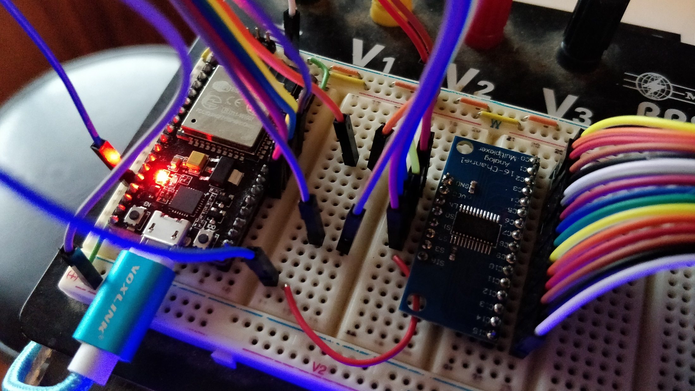

Slide 20
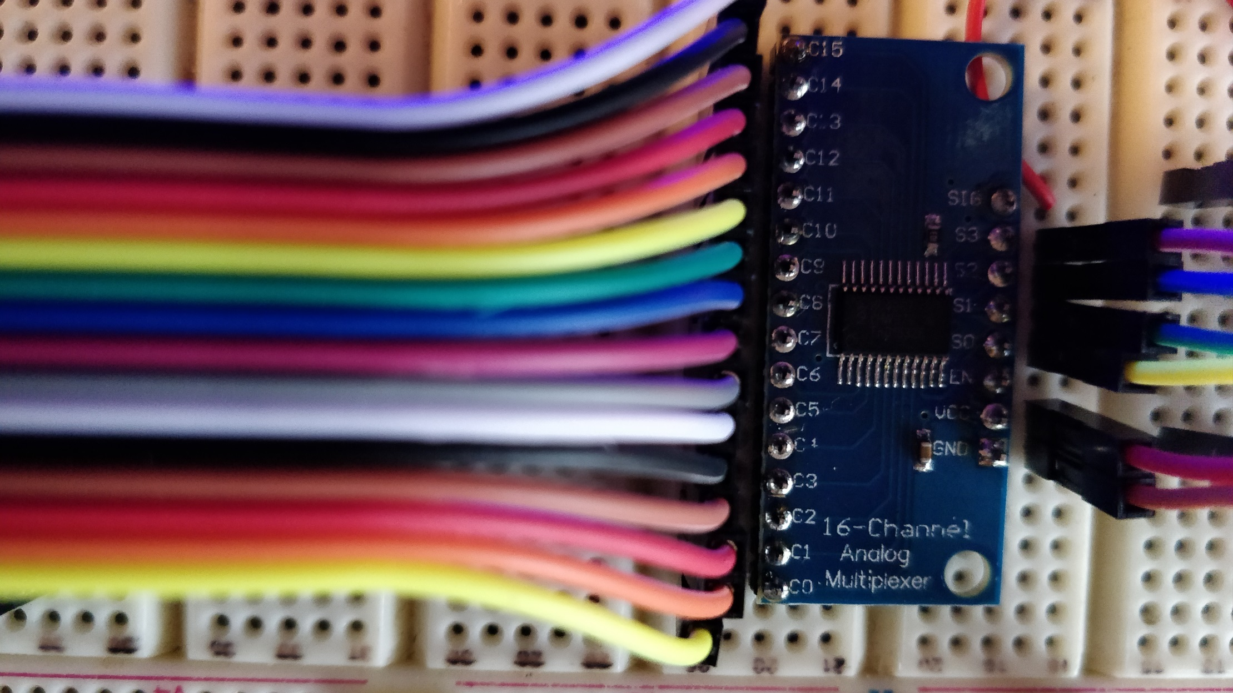

Slide 21
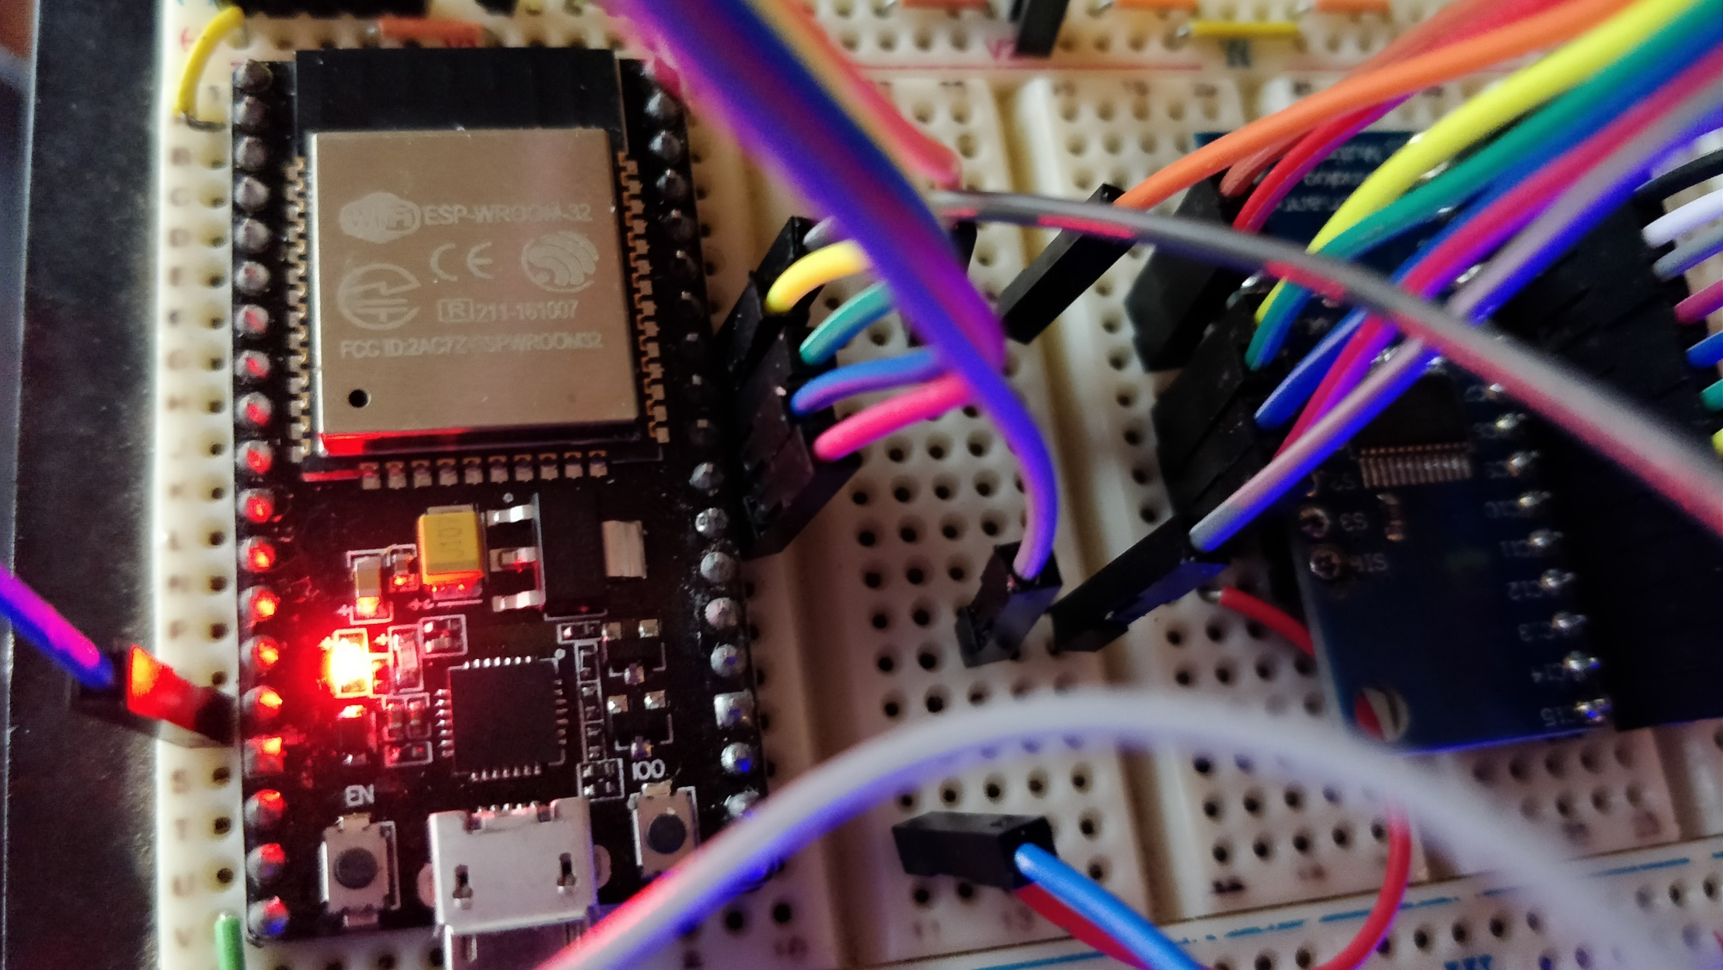

Slide 22
Touch Button Multiplexer
NodeMCD 32-S Controller
LocoNet Interface Board
LED Chain Connection

Slide 24
3 x

Slide 25
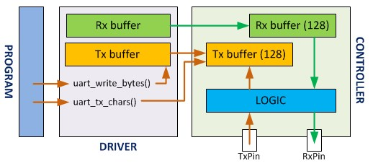
Source: http://www.lucadentella.it/en/2017/11/06/esp32-26-uart/

Slide 26
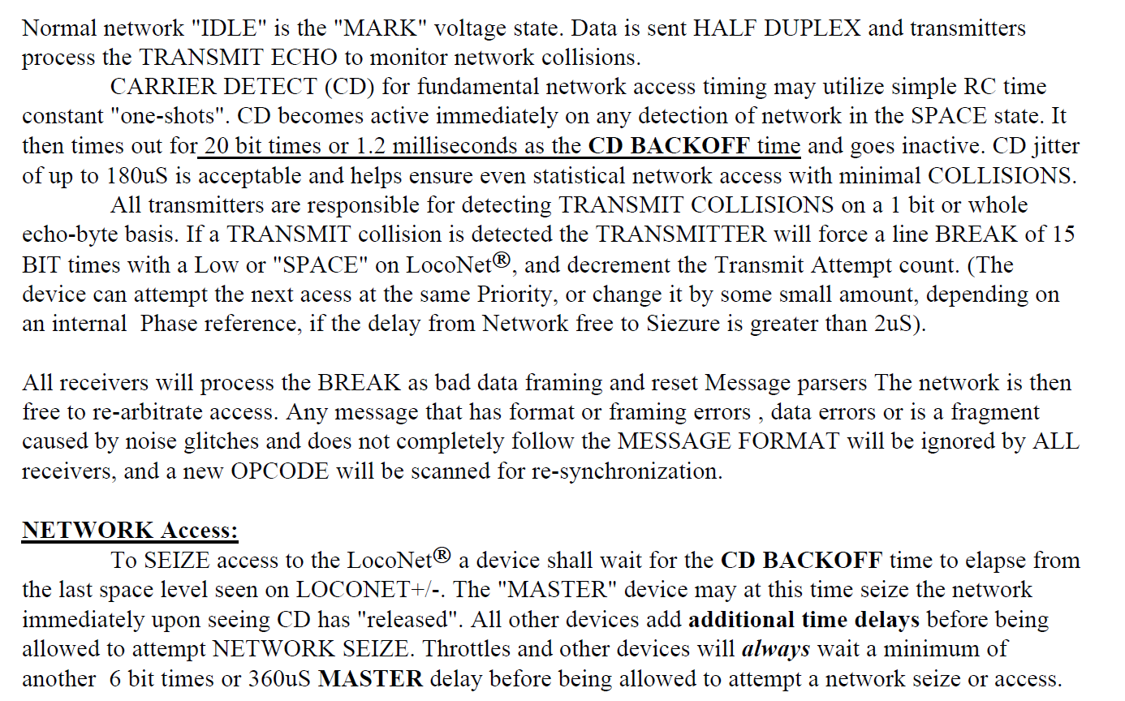
Source: LocoNet PE

Slide 27
LocoNet Application
push
pull
LocoNet Out Buffer
LocoNet In Buffer
pull
push
LocoNet Access Control and Data Transfer Task
LocoNet Access Control and Data Transfer Task
push
flow
control
pull
Hardware Transmit Buffer
Half Duplex LocoNet Interface
Hardware Receive Buffer
Transmit Copy FIFO Buffer

Slide 28
void LocoNetESPSerial::processLoop() //repeat calling this for ever from the main loop() or a separate task
{
if (digitalRead(m_rxPin) == !m_invert ? LOW : HIGH)
m_StartCD = micros();
while (HardwareSerial::available() > 0) //empty that input buffer {
int hlpInPtr = (rx_wrPos + 1) % rxBufferSize;
int hlpBuff = HardwareSerial::read();
if (ver_rdPos != ver_wrPos)
{
int hlpVerPos = (ver_rdPos + 1) % verBufferSize;
if (ver_buffer[hlpVerPos] != hlpBuff)
{
hlpBuff |= 0x0200;
HardwareSerial::flush();
sendBreakSequence();
}
ver_rdPos = hlpVerPos;
hlpBuff |= 0x0100;
}
rx_buffer[hlpInPtr] = hlpBuff;
rx_wrPos = hlpInPtr;
}
if ((tx_wrPos != tx_rdPos) && (cdBackoff() == lnNetAvailable)) {
int hlpRdPtr = (tx_rdPos + 1) % txBufferSize;
int hlpVerPtr = (ver_wrPos + 1) % verBufferSize;
if (digitalRead(m_rxPin) != !m_invert ? LOW : HIGH) //last check before sending {
HardwareSerial::write(tx_buffer[hlpRdPtr]); //send first byte
ver_buffer[hlpVerPtr] = tx_buffer[hlpRdPtr];
ver_wrPos = hlpVerPtr;
tx_rdPos = hlpRdPtr;
while (tx_wrPos != tx_rdPos) //now sending the rest back to back {
hlpRdPtr = (tx_rdPos + 1) % txBufferSize;
hlpVerPtr = (ver_wrPos + 1) % verBufferSize;
HardwareSerial::write(tx_buffer[hlpRdPtr]); //send next byte
ver_buffer[hlpVerPtr] = tx_buffer[hlpRdPtr];
ver_wrPos = hlpVerPtr;
tx_rdPos = hlpRdPtr;
}
}
}
}
LocoNet Access and Control Task
First, check if LocoNet is busy, if so reset the CD Backoff timer
Check if anything is in the receive buffer. If so, read and process it
If something is in the verification buffer, the incoming data is an echo. In this case, check for collision and set the collision flag 0x0200 if collision is detected. Also, flush the hardware buffers and set the transmit line low for 15 bit times as set forward in LocoNet PE standard.
If data is an echo, also set the Echo flag 0x0100 for the application to know.
Place received bytes in buffer for application to pick up
Check if anything needs to be sent out and LocoNet is available
If so, place data in Serial hardware buffer and copy in verification FIFO. Then place the remaining bytes of the message in the buffer as well.

Slide 29
void LocoNetESPSerial::processLoop() //repeat calling this for ever from the main loop() or a separate task
{
if (digitalRead(m_rxPin) == !m_invert ? LOW : HIGH)
m_StartCD = micros();
while (HardwareSerial::available() > 0) //empty that input buffer {
int hlpInPtr = (rx_wrPos + 1) % rxBufferSize;
int hlpBuff = HardwareSerial::read();
if (ver_rdPos != ver_wrPos)
{
int hlpVerPos = (ver_rdPos + 1) % verBufferSize;
if (ver_buffer[hlpVerPos] != hlpBuff)
{
hlpBuff |= 0x0200;
HardwareSerial::flush();
sendBreakSequence();
}
ver_rdPos = hlpVerPos;
hlpBuff |= 0x0100;
}
rx_buffer[hlpInPtr] = hlpBuff;
rx_wrPos = hlpInPtr;
}
if ((tx_wrPos != tx_rdPos) && (cdBackoff() == lnNetAvailable)) {
int hlpRdPtr = (tx_rdPos + 1) % txBufferSize;
int hlpVerPtr = (ver_wrPos + 1) % verBufferSize;
if (digitalRead(m_rxPin) != !m_invert ? LOW : HIGH) //last check before sending {
HardwareSerial::write(tx_buffer[hlpRdPtr]); //send first byte
ver_buffer[hlpVerPtr] = tx_buffer[hlpRdPtr];
ver_wrPos = hlpVerPtr;
tx_rdPos = hlpRdPtr;
while (tx_wrPos != tx_rdPos) //now sending the rest back to back {
hlpRdPtr = (tx_rdPos + 1) % txBufferSize;
hlpVerPtr = (ver_wrPos + 1) % verBufferSize;
HardwareSerial::write(tx_buffer[hlpRdPtr]); //send next byte
ver_buffer[hlpVerPtr] = tx_buffer[hlpRdPtr];
ver_wrPos = hlpVerPtr;
tx_rdPos = hlpRdPtr;
}
}
}
}
LocoNet Access and Control Task
First, check if LocoNet is busy, if so reset the CD Backoff timer
Check if anything is in the receive buffer. If so, read and process it
If something is in the verification buffer, the incoming data is an echo. In this case, check for collision and set the collision flag 0x0200 if collision is detected. Also, flush the hardware buffers and set the transmit line low for 15 bit times as set forward in LocoNet PE standard.
If data is an echo, also set the Echo flag 0x0100 for the application to know.
Place received bytes in buffer for application to pick up
Check if anything needs to be sent out and LocoNet is available
If so, place data in Serial hardware buffer and copy in verification FIFO. Then place the remaining bytes of the message in the buffer as well.

Slide 30
void LocoNetESPSerial::processLoop() //repeat calling this for ever from the main loop() or a separate task
{
if (digitalRead(m_rxPin) == !m_invert ? LOW : HIGH)
m_StartCD = micros();
while (HardwareSerial::available() > 0) //empty that input buffer {
int hlpInPtr = (rx_wrPos + 1) % rxBufferSize;
int hlpBuff = HardwareSerial::read();
if (ver_rdPos != ver_wrPos)
{
int hlpVerPos = (ver_rdPos + 1) % verBufferSize;
if (ver_buffer[hlpVerPos] != hlpBuff)
{
hlpBuff |= 0x0200;
HardwareSerial::flush();
sendBreakSequence();
}
ver_rdPos = hlpVerPos;
hlpBuff |= 0x0100;
}
rx_buffer[hlpInPtr] = hlpBuff;
rx_wrPos = hlpInPtr;
}
if ((tx_wrPos != tx_rdPos) && (cdBackoff() == lnNetAvailable)) {
int hlpRdPtr = (tx_rdPos + 1) % txBufferSize;
int hlpVerPtr = (ver_wrPos + 1) % verBufferSize;
if (digitalRead(m_rxPin) != !m_invert ? LOW : HIGH) //last check before sending {
HardwareSerial::write(tx_buffer[hlpRdPtr]); //send first byte
ver_buffer[hlpVerPtr] = tx_buffer[hlpRdPtr];
ver_wrPos = hlpVerPtr;
tx_rdPos = hlpRdPtr;
while (tx_wrPos != tx_rdPos) //now sending the rest back to back {
hlpRdPtr = (tx_rdPos + 1) % txBufferSize;
hlpVerPtr = (ver_wrPos + 1) % verBufferSize;
HardwareSerial::write(tx_buffer[hlpRdPtr]); //send next byte
ver_buffer[hlpVerPtr] = tx_buffer[hlpRdPtr];
ver_wrPos = hlpVerPtr;
tx_rdPos = hlpRdPtr;
}
}
}
}
LocoNet Access and Control Task
First, check if LocoNet is busy, if so reset the CD Backoff timer
Check if anything is in the receive buffer. If so, read and process it
If something is in the verification buffer, the incoming data is an echo. In this case, check for collision and set the collision flag 0x0200 if collision is detected. Also, flush the hardware buffers and set the transmit line low for 15 bit times as set forward in LocoNet PE standard.
If data is an echo, also set the Echo flag 0x0100 for the application to know.
Place received bytes in buffer for application to pick up
Check if anything needs to be sent out and LocoNet is available
If so, place data in Serial hardware buffer and copy in verification FIFO. Then place the remaining bytes of the message in the buffer as well.

Slide 31
Summary
The ESP 32 is an incredibly powerful controller. To me, the core features make it the controller of choice for a lot of projects
The Touch feature is very promising and a good basis for the touch operation on the CTC panel
The strength of the touch signals is sufficient even when feeding them through an analog multiplexer. This allows for 64 buttons on the CTC panel with no problems
Thanks to 3 hardware serial ports on the ESP32 it is possible to use one for the LocoNet communication

Slide 32


Slide 33
Touch Pad API: https://github.com/espressif/arduino-esp32/blob/master/tools/sdk/include/driver/driver/touch_pad.h
Touch Pad Specs: https://docs.espressif.com/projects/esp-idf/en/latest/api-reference/peripherals/touch_pad.html#
ESP32 Documentation: https://www.espressif.com/en/products/hardware/esp32/resources
ESP32 Technical Manual: https://www.espressif.com/sites/default/files/documentation/esp32_technical_reference_manual_en.pdf
74HC4067 Data Sheet: https://assets.nexperia.com/documents/data-sheet/74HC_HCT4067.pdf
74HC4067 MUX: https://www.amazon.com/HiLetgo-CD74HC4067-Channel-Multiplexer-Breakout/dp/B01DLHKLNE/ref=sr_1_1?ie=UTF8&qid=1545841731&sr=8-1&keywords=74HC4067
Additional Materials on Github: https://github.com/tanner87661/-IoTT-Video10
Layout Intro Sequence Outdoor Layout: Beat Deola, Switzerland​

Slide 34
IFTTT Sequences
IF THIS (TRUE or FALSE Condition) | THAN THAT (Action List) | ELSE (or nothing, Action List)
BD(x)=1 | LED(x)=[12,15,27] | LED(x)=[0,0,0]
BD(x)=1 && BD(y)=0
SWI(12)=LEFT_ON | LED(x)=[255,0,0]
SWI(12)=LEFT_OFF | LED(x)=[127,0,0]
SWI(12)=LEFT | LED(x)=[255,0,0]
BUT(1)=DOWN | SWI(25)=[LEFT,ON]; SWI(24)=[LEFT,PULSE]
BUT(2)=HOLD
BUT(3)=UP
BUT(4)=FREE

Slide 35
JSON Sequences
Command Line
{"IfThis": "BD(x) = 1 && BD(y) = 0","ThenThat": "LED(x) = [12, 15, 27]","OrElse": "LED(x) = [0, 0, 0]"}
Command List
{
"ListName": "ThisCTC",
"Commands":
[
{
"IfThis": "BD(12) = 1 && BD(5) = 0","ThenThat": "LED(18) = [12, 15, 27]","OrElse": "LED(18) = [0, 0, 0]"
},
{
"IfThis": "BD(15) = 1 && BD(18) = 0","ThenThat": "LED(25) = [12, 15, 27]"
}
]
}

Slide 36
CTC Panel Modes
Mode | Description | Bushby Bit | CTC Swi Command
ENABLED | LED’s show BD and Turnout status, button input accepted and processed, using OPC_SW_REQ | OFF | OPC_SW_REQ
REQUEST | LED’s show BD and Turnout status, button input accepted and processed, using OPC_SW_REQ, must be confirmed by a master by sending OPC_SW_ACK | ON | OPC_SW_REQ
MASTER | LED’s show BD and Turnout status, button input accepted and processed, using OPC_SW_ACK commands (Bushby override) | D/C | OPC_SW_ACK
OFF | LED’s dark, button input not accepted, OFF Status LED ON to show readiness | D/C | None
REMOTE | LED’s show BD and Turnout status, button input not accepted, power LED ON | D/C | None
 | MASTER – NORMAL – REMOTE – POWER

